Slide 1



Local Network
Riley Robot n
Public Network
Static-IP=192.168.137.22
ROS_DOMAIN_ID=2
Server side
Riley Robot 1
Static-IP=192.168.137.10
ROS_DOMAIN_ID= …?
Static-IP=192.168.137.11
ROS_DOMAIN_ID=1

Slide 2
Public Network
Local Network
Riley Robot n:
Client Hotspot: RileyHotspot
WiFi internet
ROS2 topics
Hardware: Raspberry Pi 4B (8GB ram)
OS: Ubuntu server 20.04 LTS
Static-IP=192.168.137.22
ROS2 topics
Server side:
ROS_DOMAIN_ID=1
Hosting Hotspot: RileyHotspot
ROBOT_ID=n
Riley Robot 1:
Client Hotspot: RileyHotspot
OS: Ubuntu desktop 20.04 LTS
Static-IP=192.168.137.10
Hardware: Raspberry Pi 4B (8GB ram)
ROS_DOMAIN_ID= 1
OS: Ubuntu server 20.04 LTS
Static-IP=192.168.137.11
ROS_DOMAIN_ID=1
ROBOT_ID=1

Slide 3
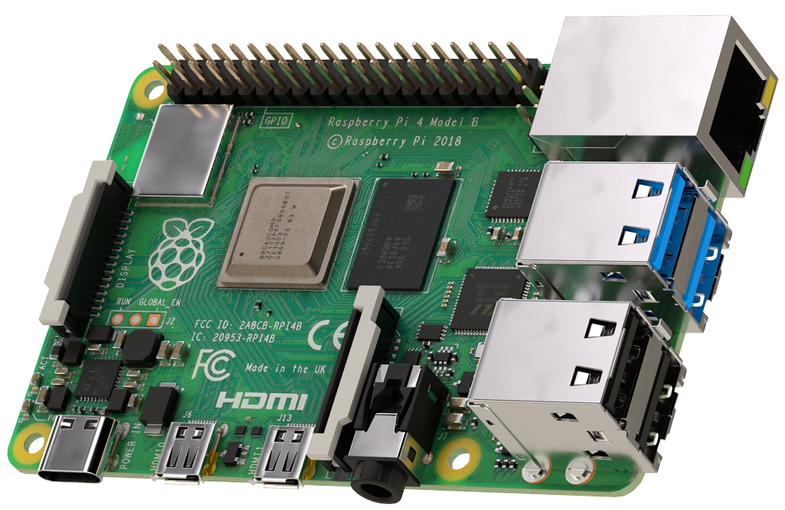
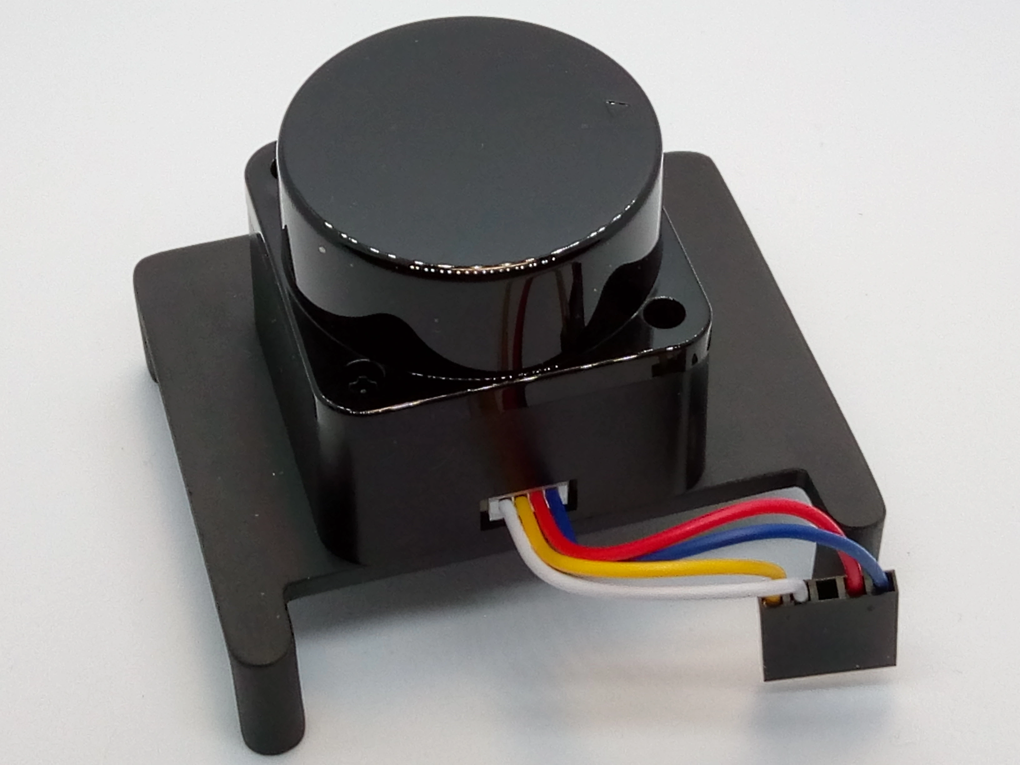

ROS2 (Ubuntu server 20.04)
UART
ROS2 Topics
ROS2 (Ubuntu core 20.04)

Slide 4
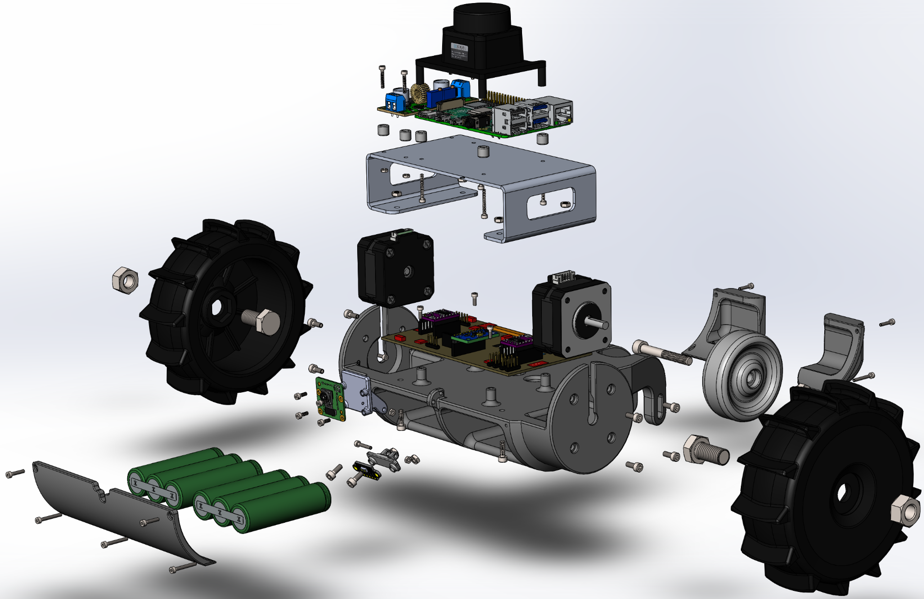
(4x) M2.5x12 Socket screw
13
1
LiDAR_LD06 module
LM2596S stepdown converter
14
2
Raspberry pi 4B
(4x) M2.5 nuts
15
3
(8x) Spacer 6mm
(4x) M2x20mm Socket screw
16
4
3thFloor sheet metal
(2x) Nema17 Steppermotor
17
5
(4x) M3 nuts
(8x) M3x8 Socket screw
18
6
(4x) M3x10 Socket screw
(2x) BuggyWheel
19
7
PCB assembly
20
(2x) M10 nut
8
MiddelPart assembly
9
M6x45 Socket screw
10
(2x) Backbatterycover
11
(2x) M2x10 Socket screw
12
(2x) M2x16 Socket screw
21
Front BatteryCover
22
V2 pi camera
23
(4x) M2x6 Socket screw
Lithium-ion BatteryPack
24
29
(4x) M3x10 Socket screw
M5 nut
35
30
Camera Mount
36
31
BackWheel
(2x) M3 nut
(2x) M10x20 hex bolt
37
32
(2x) M2 nut
25
27
33
(3x) M2x10 Socket screw
(2x) M3x8 Socket screw
TimeOfFlight Mount
26
28
34
(3x) M2x16 Socket screw
VL53L1X ToF sensor
(2x) M2x12 Socket screw

Slide 5
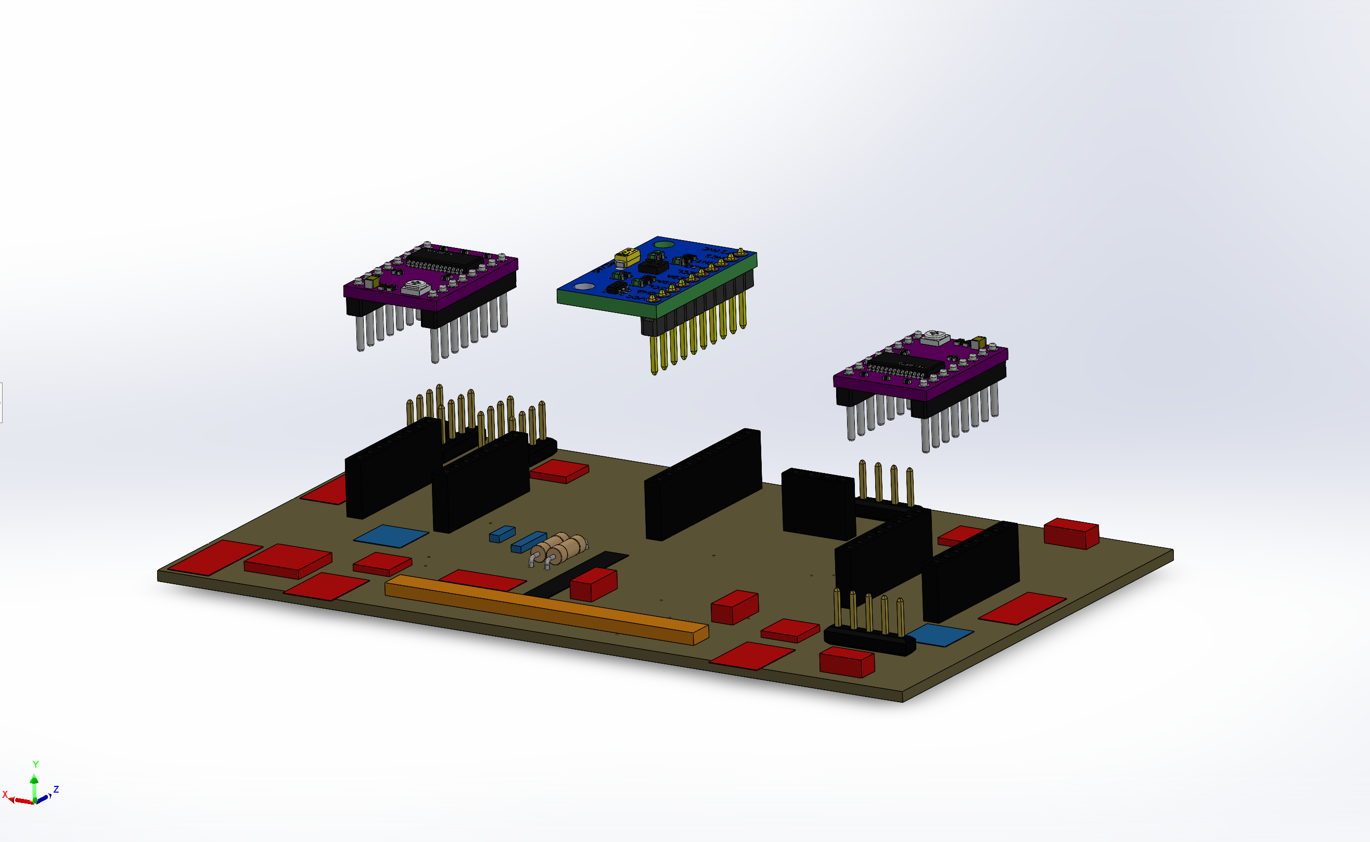
1
DRV8825 StepperDriver
2
MPU-9250 9DOF module
3
Custom PCB board
4
Current and Voltage meter (not modeled)

Slide 6
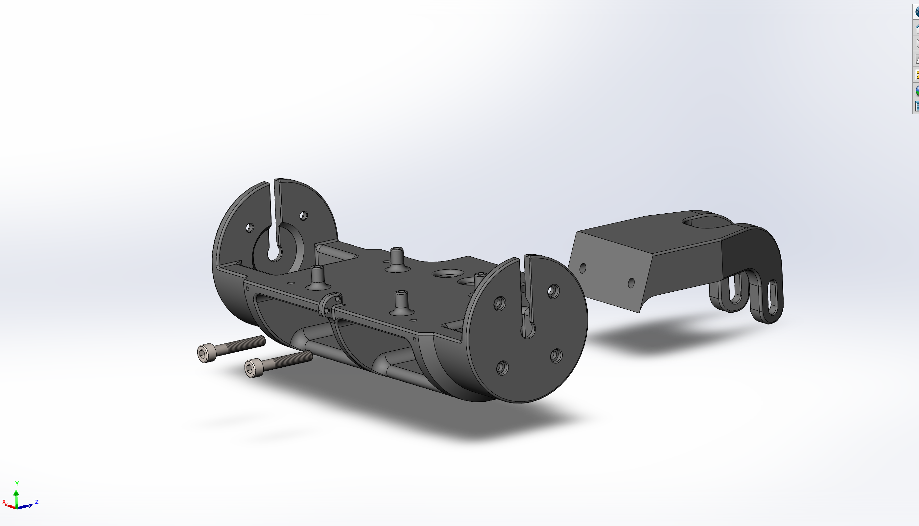
1
MiddlePart
2
(2x) M5x30 Socket screw
3
TailPart

